Slide 1
ANALYSIS CONDUCTED ONLY ON 311 STARTUPS
OPEN INNOVATION PRACTICES (Q13 to be reversed)
INNOVATIVENESS (Q12)
REVENUE GROWTH (Q4_2)
TECHNOLOGICAL RESOURCES (Q14)
ADVANCED ICT (AI, CYBER, CLOUD)
INDUSTRY 5.0 (ROBOTICS, IOT, BLOCKCHAIN,NANOMICROELETTRONICA)
GREEN TECHNOLOGIES

Slide 2
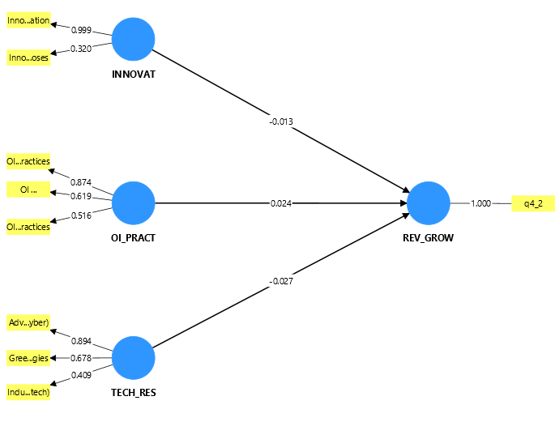

Slide 3
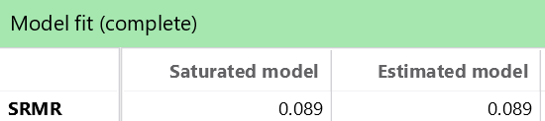
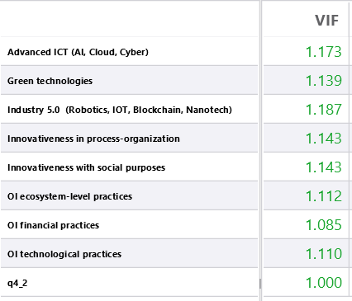
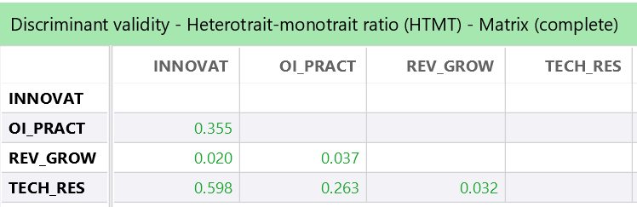
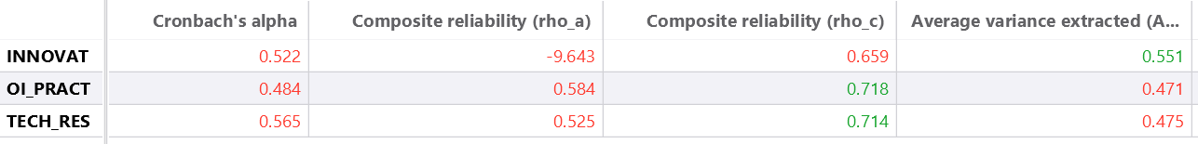

Slide 4
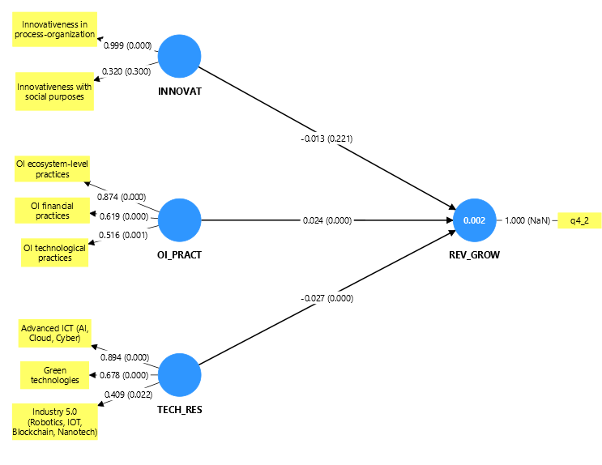
NON SIGNIFICATIVA
POSITIVAMENTE SIGNIFICATIVA
NEGATIVAMENTE SIGNIFICATIVA

